Slide 1
MAT Conference
May, 2012
Resampling with TinkerPlots
Jane Watson
University of Tasmania

Slide 2
What is Resampling?
It is a process that can lead to decision-making with data that does not depend on theoretical statistics.
It is currently controversial in the world of statistics education and curriculum development.
Personally I would like to see it in the Year
11/12 Australian Mathematics Curriculum.

Slide 3
Decision Making in Statistics
Statistics is about carrying out investigations with data from samples to answer questions about populations or with data from experiments to draw causal inferences.
At some point in the development of understanding of the inferential process, probabilistic reasoning becomes involved because the decisions about the questions cannot be made with certainty.
The question is: what processes are used?

Slide 4
Inference: Formal and Informal
Formal inference is what statisticians do based on the assumptions underlying the normal distribution to carry out hypothesis tests, etc.
Informal inference is what school students do when evidence is used to make a generalisation beyond the data with an acknowledgement of uncertainty.
  Evidence: height data from my Grade 5 class
  Generalisation: what can I say about all Grade 5 students in Australia?
  Uncertainty: How confident am I about this?

Slide 5
Informal Inference via Resampling
Resampling methods offer a way of gathering evidence to support a generalisation that can be reported with an associated frequency-based probability.
Resampling refers to the use of the observed data or of a data generating mechanism (such as a die) to produce new hypothetical samples, the results of which can then be analysed (Simon, 1997).

Slide 6
Informal Inference via Resampling
The process then recalculates the value of the statistic of interest for the resampled data, perhaps the difference in the group means or medians.
This is done many times to estimate the relative frequency (probability) with which the original difference (or more extreme) would be expected to occur compared to the differences with random reallocation.

Slide 7
Resampling
Contexts
  Compare proportions from 2-way tables
  Compare means/medians for 2 groups
  Estimate a population mean
  Estimate a correlation coefficient
  Estimate a confidence interval
Programs
  Minitab
  Excel
  R
  Fathom
  Applets (Rossman & Chance)
  TinkerPlots

Slide 8
Example using TinkerPlots
(Shaughnessy et al., 2009)
Is it easier for people to memorise meaningful words than nonsense words?
Two lists of 3-letter words: one a list of meaningful words and the other nonsense words.
The lists are randomly distributed face-down to members of the class, one to a student.
Students are told to turn the sheet over and spend 30 seconds memorising the words.
They then turn the sheet over and write as many words as they can remember on the back of the sheet.

Slide 9
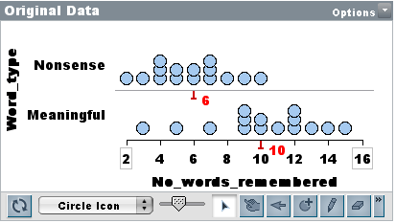
Compare performances on the two lists
Class data: Is it easier to remember meaningful or nonsense words?
How unusual is the difference?

Slide 10
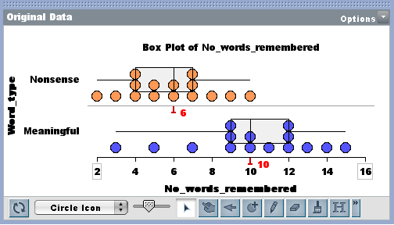
Using box plots from Year 10
Using Chris Wild’s criteria, no overlap of the boxes means 3/4 of “Nonsense” are to the left of 3/4 “Meaningful.” There appears to be evidence for a difference.

Slide 11
Resampling with TinkerPlots
Data from class in Data Cards and Table.
Set up Sampler to reassign the data randomly (No_words_remembered) without replacement to the two conditions.
Use the Ruler to measure the “new” difference in medians.
Use the History button to record this and repeat “many” times.
See how many times the difference is at least as large as the class difference of 4.

Slide 12
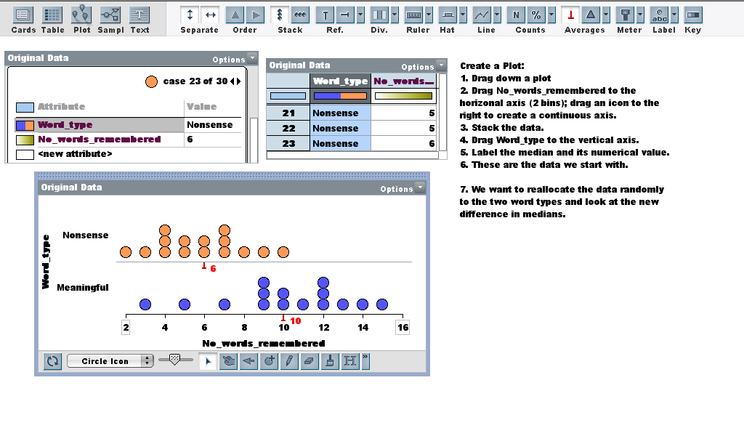

Slide 13
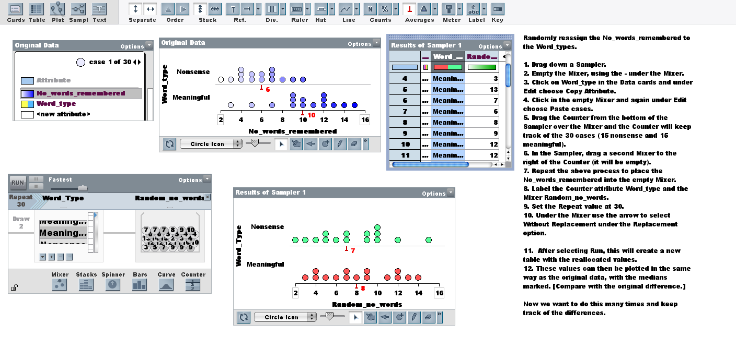

Slide 14
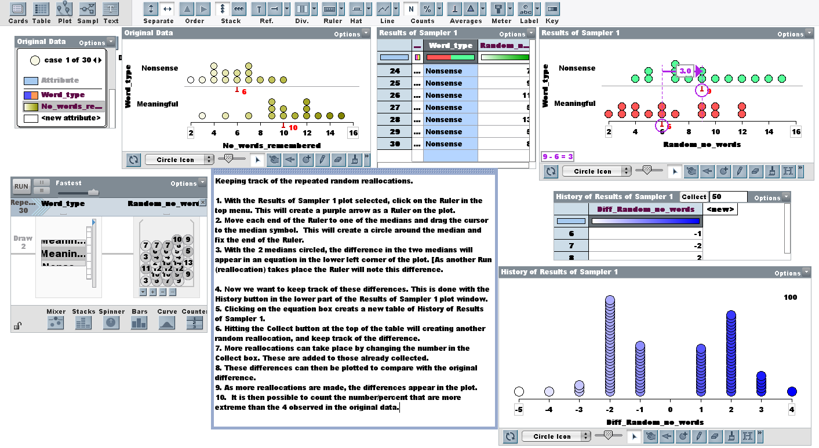

Slide 15
A Second Example: Swimming with Dolphins
30 patients diagnosed with mild to moderate depression were randomly allocated to two treatment groups where they engaged in the same amount of time swimming and snorkelling each day for four weeks.
One group participated in the presence of bottlenose dolphins and the other did not. The patients had no other treatment.

Slide 16
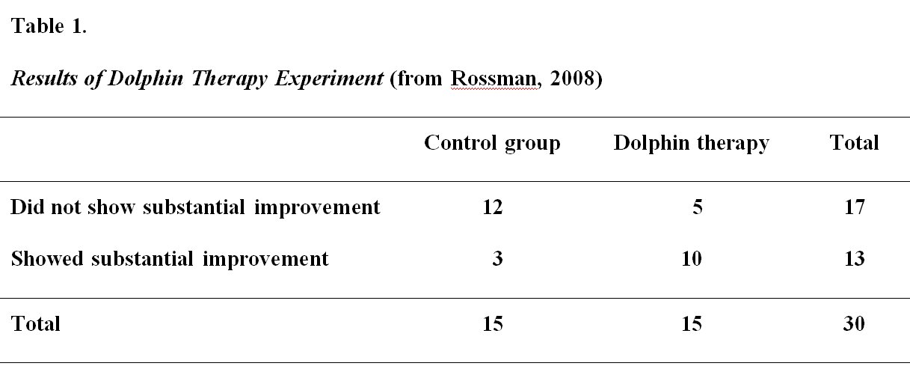
A Second Example: Swimming with Dolphins

Slide 17
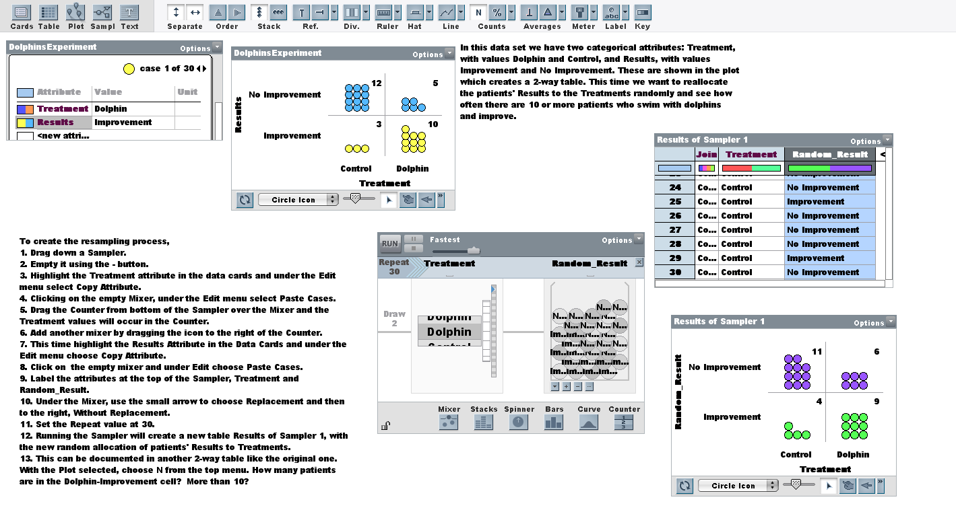

Slide 18
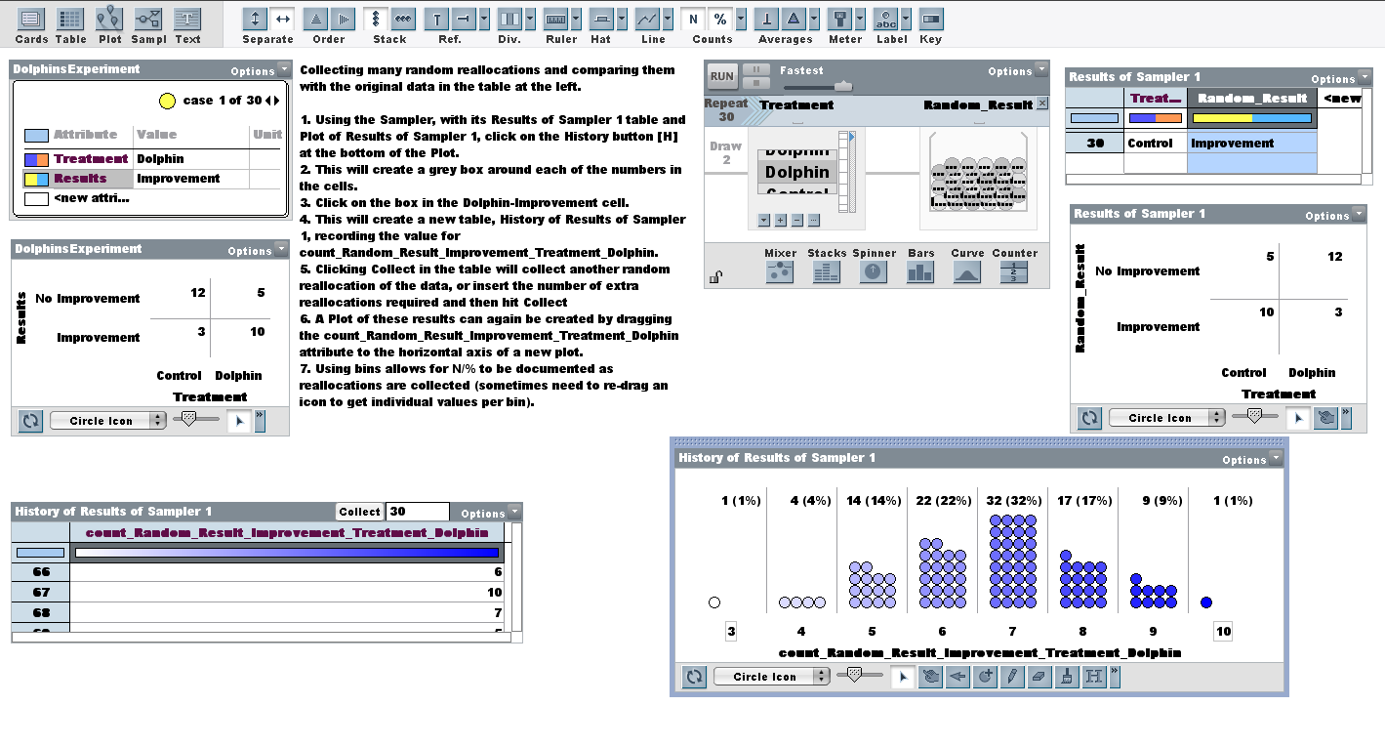

Slide 19
Benefits of Resampling
Concrete – can be done “by hand first.”
Students can “see” how unlikely (or otherwise) an outcome is.
There is no theoretical baggage beyond random sampling.
Put it in the Year 11/12 curriculum.

